Slide 1
CHAPTER 8
GRAY-LEVEL TRANSFORMATIONS

Slide 2
WHAT WILL WE LEARN?
What does it mean to “enhance” an image?
How can image enhancement be achieved using gray-level transformations?
What are the most commonly used gray-level transformations and how can they be implemented using MATLAB?

Slide 3
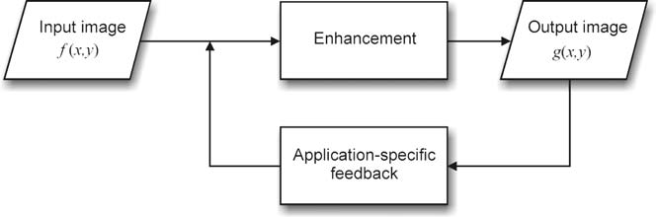
Image enhancement in the spatial domain
Image enhancement has 2 goals:
Improve the subjective quality of an image for human viewing
Modify the image to make it more suitable for further analysis and automatic extraction of its contents

Slide 4
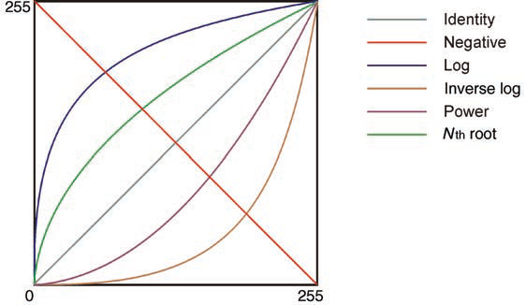
SPATIAL TRANSFORMATIONS
g(x,y)= T[f(x,y)]
Or s = T [r]
Point transformations may be linear (e.g., negative), piecewise linear (e.g., graylevel slicing), or nonlinear (e.g., gamma correction)
Examples of basic linear (identity and negative) and nonlinear (log, inverse log, power, also known as gamma, and n^{th} root) transformation functions.

Slide 5
Linear point transformations
s = c ・ r + b
c: controlling the contrast of the output image
b : impacts the output image’s overall brightness

Slide 6
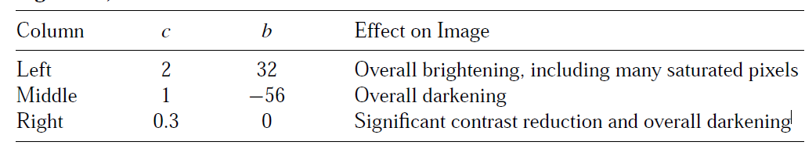
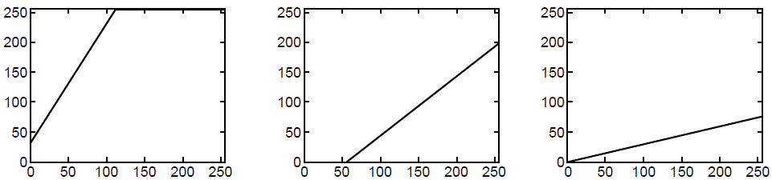
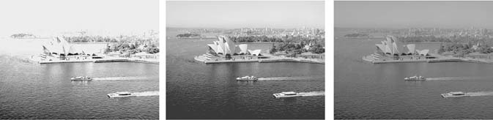
Example

Slide 7
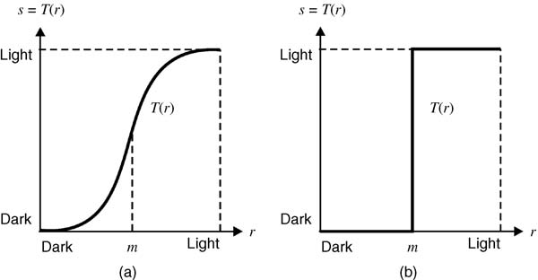
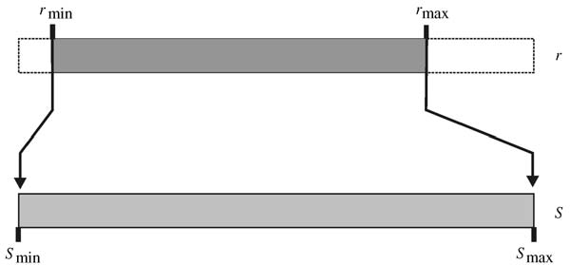

Contrast Manipulation
Contrast manipulation:
f < m are compressed toward darker values in the output image
f > m are mapped to brighter pixel values in the resulting image
autocontrast function

Slide 8
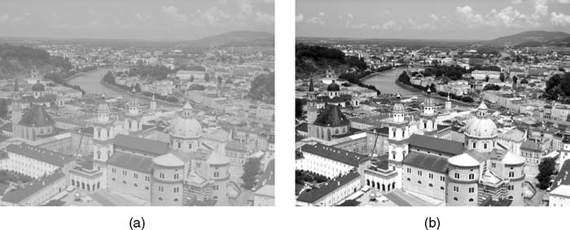
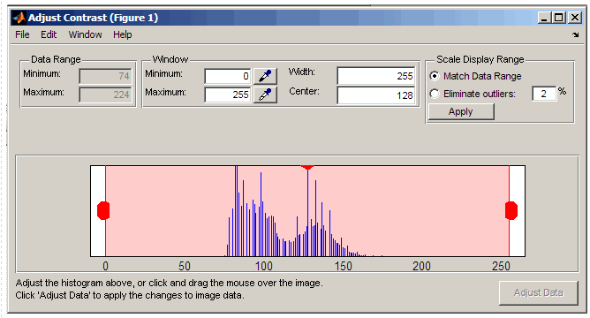
In MATLAB
Imcontrast:
creates an Adjust Contrast tool in a separate figure that is associated with the grayscale image in the current figure
use to adjust the black-to-white mapping used to display the image

Slide 9
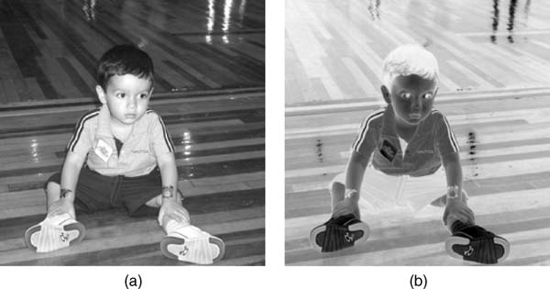
Negative (contrast reverse)
g = −f + Lmax
In matlab:
IM2 = imcomplement(IM)

Slide 10
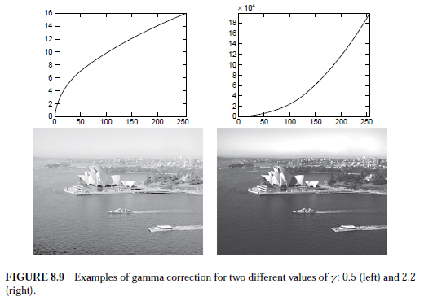
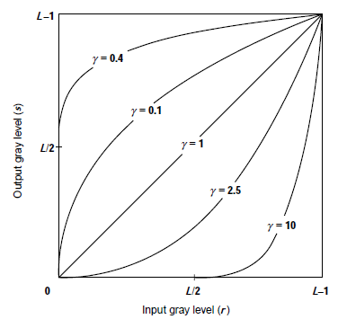
Power Law (Gamma) Transformations
Matlab:
g = imadjust(f,[],[],gamma);

Slide 11
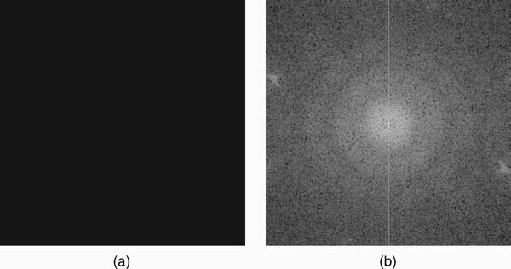
Log Transformations
s = c ・ log(1 + r)

Slide 12
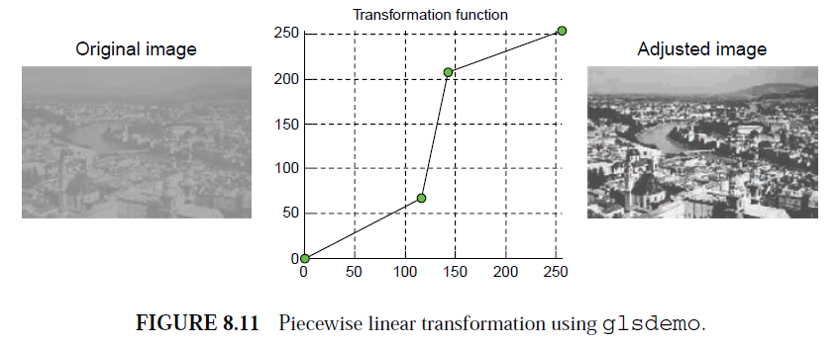
Piecewise Linear Transformations

Slide 13
SPECIFYING THE TRANSFORMATION FUNCTION
See the examples 8.5, 8.6

Slide 14
Hands on
TUTORIAL 8.1 <page 163>
PROBLEMS <page 169>

Slide 15
x = 0:255; c = 255 / log(256);
y = c * log(x + 1);
figure, subplot(2,2,1), plot(y),title('Log Mapping Function'), axis tight, axis square
I = imread('face.jpg');
I_log = uint8(y(I + 1));
subplot(2,2,2), imshow(I), title('Original Image');
subplot(2,2,3), imshow(I_log), title('Adjusted Image');

